Slide 1

Computer Networks
BCST -502 BCSP- 502
B.Tech (CSE) 5th Semester
Course Instructor: Dr Bishwajeet Pandey

Slide 2
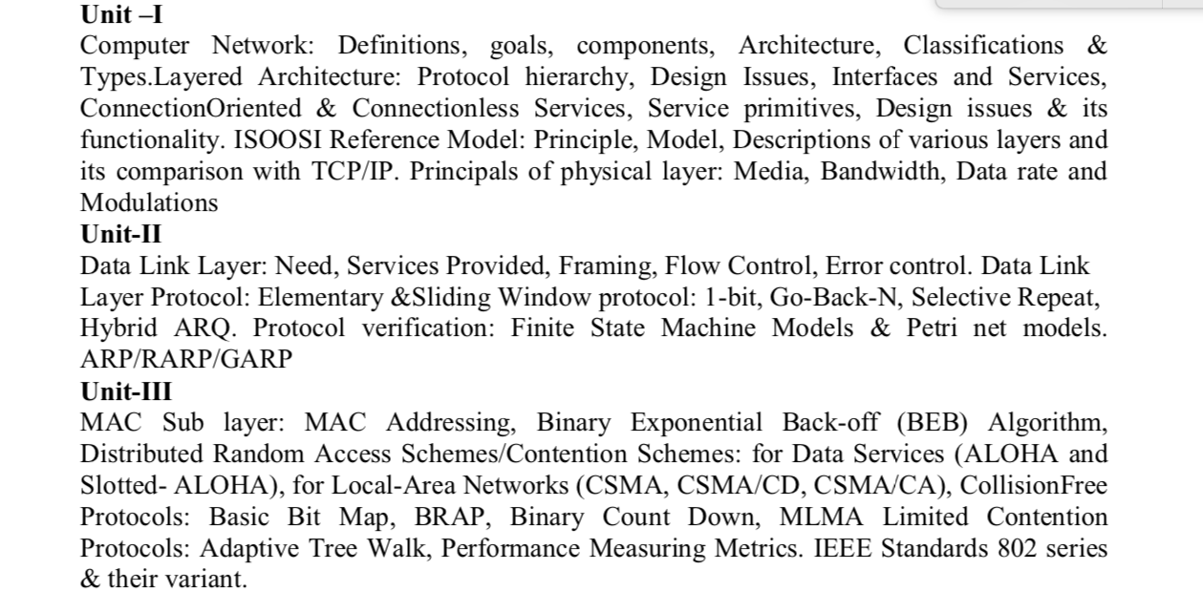
New 2020 Syllabus

Slide 3
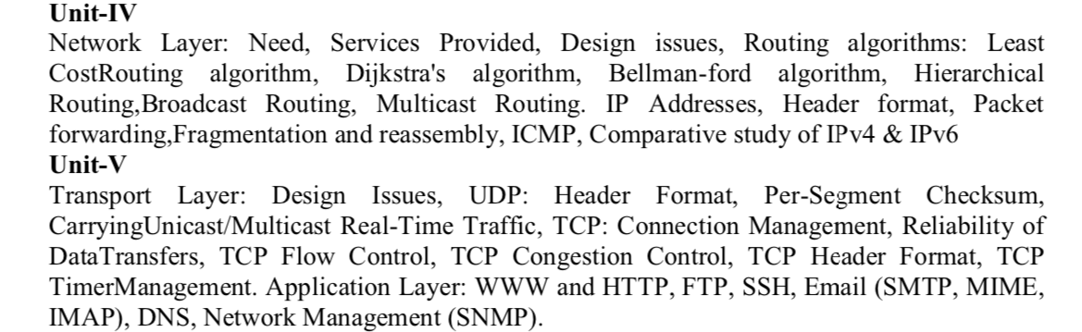
New 2020 Syllabus

Slide 4

About Course Instructor
PhD from Gran Sasso Science Institute, Italy
PhD Supervisor Prof Paolo Prinetto from Politecnico Di Torino, World Rank 13 in Electrical Engineering
MTech from Indian Institute of Information Technology, Gwalior
Scopus Profile: https://www.scopus.com/authid/detail.uri?authorId=57203239026
Google Scholar: https://scholar.google.com/citations?user=UZ_8yAMAAAAJ&hl=hi
Contact: gyancity@gyancity.com, +91-7428640820 (For help in this Subject @ BIAS and Guidance for future MS from Europe and USA after BIAS)

Slide 5
About Course Outline
UNIT 1: Lecture No 1-4
UNIT 2: Lecture No 5-11 (Including Lab on Vivado)
UNIT 3: Lecture No 14-18
UNIT 4: Lecture No 19-21, Lecture 12-13
Student Assignment Presentation: Lecture 22-23
Lab on Packet Tracer and C: Lecture 24-26
UNIT 5: Lecture No 27-30
Lecture No 31-35: Discuss Previous Year Question of UKTU
Out of 35 Lectures: Some will delivered by Professor From Foreign University

Slide 6
OUTLINE OF LECTURE 26
C Program of Bit Stuffing
C Program of Dijkstra's Algorithm For Shortest Paths
C Program of Distance Vector Routing, implemented using Bellman Ford Algorithm

Slide 7
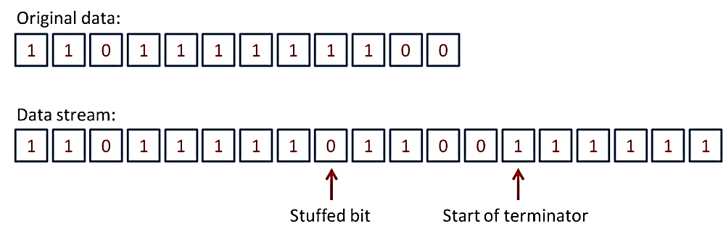
Bit Stuffing
For example, we can define a rule that no more than five 1s can occurring a row in the transmitted data. To make this work, the sending software/hardware will insert (stuff) an extra 0 after any sequence of five 1s. It can then send a sequence of six 1s specifically to indicate an end of data set. The receiver, on seeing a sequence of five 1s,checks the next bit. If it is 0, the bit is simply discarded; if it is1, then it notes that an end of data set has been flagged. This technique is very flexible and can be adapted to various circumstances. It is broadly the same idea as using an “escape” character in byte-oriented protocols. Here is an example:

Slide 8
C Program of Bit Stuffing
/*Implementation of Bit stuffing Using C */
#include<stdio.h>
#include<string.h>
void main()
{
int i, j,count=0,nl;
char str[10];
printf("enter the bit string less than 9 length: ");
scanf("%s",str);
for (i=0;i<strlen(str);i++) {
count=0;
//the following code search the six ones in given string
for (j=i;j<=(i+5);j++) {
if(str[j]=='1') {
count++;
}
}
//if there is six ones then following code execute to bit stuffing after five ones
if(count==6) {
nl=strlen(str)+2;
for (;nl>=(i+5);nl--) {
str[nl]=str[nl-1];
}
str[i+5]='0';
i=i+7;
}
}
puts(str);
}

Slide 9
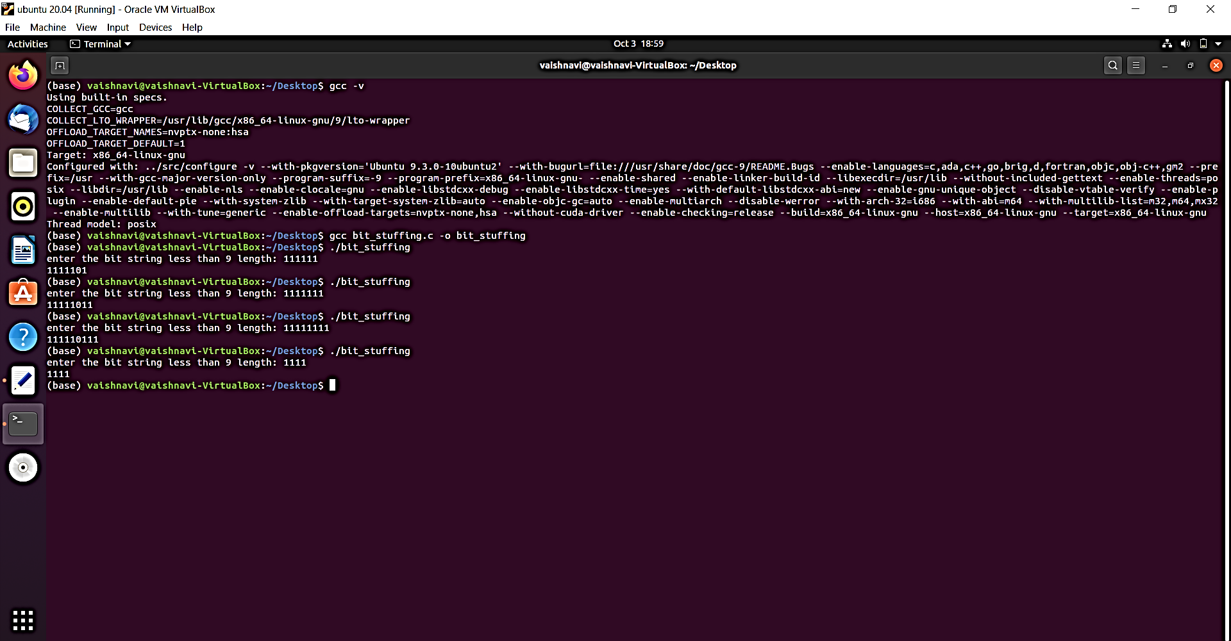

Slide 10
Dijkstra's Algorithm For Shortest Paths
∞
∞
2
8
3
if( d[v] + c[v,i] < d[i])
{
d[i] = d[v] + c[v,i]
}
4
0
0
11
7
v: input vertex, i: final vertex, d: distance, c: cost
8
1
Let input vertex v be 0
According to the graph on the left, vertex 0 is directly connected with vertex 2 and vertex 1.
0 → 1
0 → 2
To calculate the distance from vertex 0 to vertex 1:
d[0] = 0, c[0,1] = 8, d[1] = ∞ // i = 1
d[0] + c[0,1] = 0+8 = 8 < ∞
d[i] = d[1] = 8
∞

Slide 11
Result
vertices | 1 | 2 | 3
Shortest Distance from vertex 0 | 8 | 4 | 12

Slide 12
C Program of Dijkstra's Algorithm For Shortest Paths
#include<stdio.h>
#include<ctype.h>
#define infinity 999
void dij(int n ,int v, int cost[10][10],int dist[])
{
int i,u,count,w,flag[10],min;
for(i=1;i<=n;i++)
flag[i]=0,dist[i]=cost[v][i];
count=2;
while(count<=n)
{
min=99;
for(w=1;w<=n;w++)
if(dist[w]<min && !flag[w])
min=dist[w],u=w;
flag[u]=1;
count++;
for(w=1;w<=n;w++)
if((dist[u]+cost[u][w]<dist[w]) && !flag[w])
dist[w]=dist[u]+cost[u][w];
}
}
void main()
{
int n, v,i,j,cost[10][10],dist[10];
printf("\n Enter the number of nodes:");
scanf("%d",&n);
printf("\n Enter the cost matrix:\n");
for(i=1;i<=n;i++)
for(j=1;j<=n;j++)
{
scanf("%d",&cost[i][j]);
if(cost[i][j]==0)
cost[i][j]=infinity;
}
printf("\n Enter the source matrix:");
scanf("%d",&v);
dij(n,v,cost,dist);
printf("\n Shortest path:\n");
for(i=1;i<=n;i++)
if(i!=v) printf("%d->%d,cost=%d\n",v,i,dist[i]);
getchar();
}

Slide 13
Working of the code
v = 3
Number of nodes = 3 Cost matrix =
Input vertex = 3
dist[1] = 7 // 3 → 1
dist[2] = 8 // 3 → 2
dist[3] = 9 // 3 → 3
 | 1 | 2 | 3
1 | 1 | 2 | 3
2 | 4 | 5 | 6
3 | 7 | 8 | 9
v = 3

Slide 14
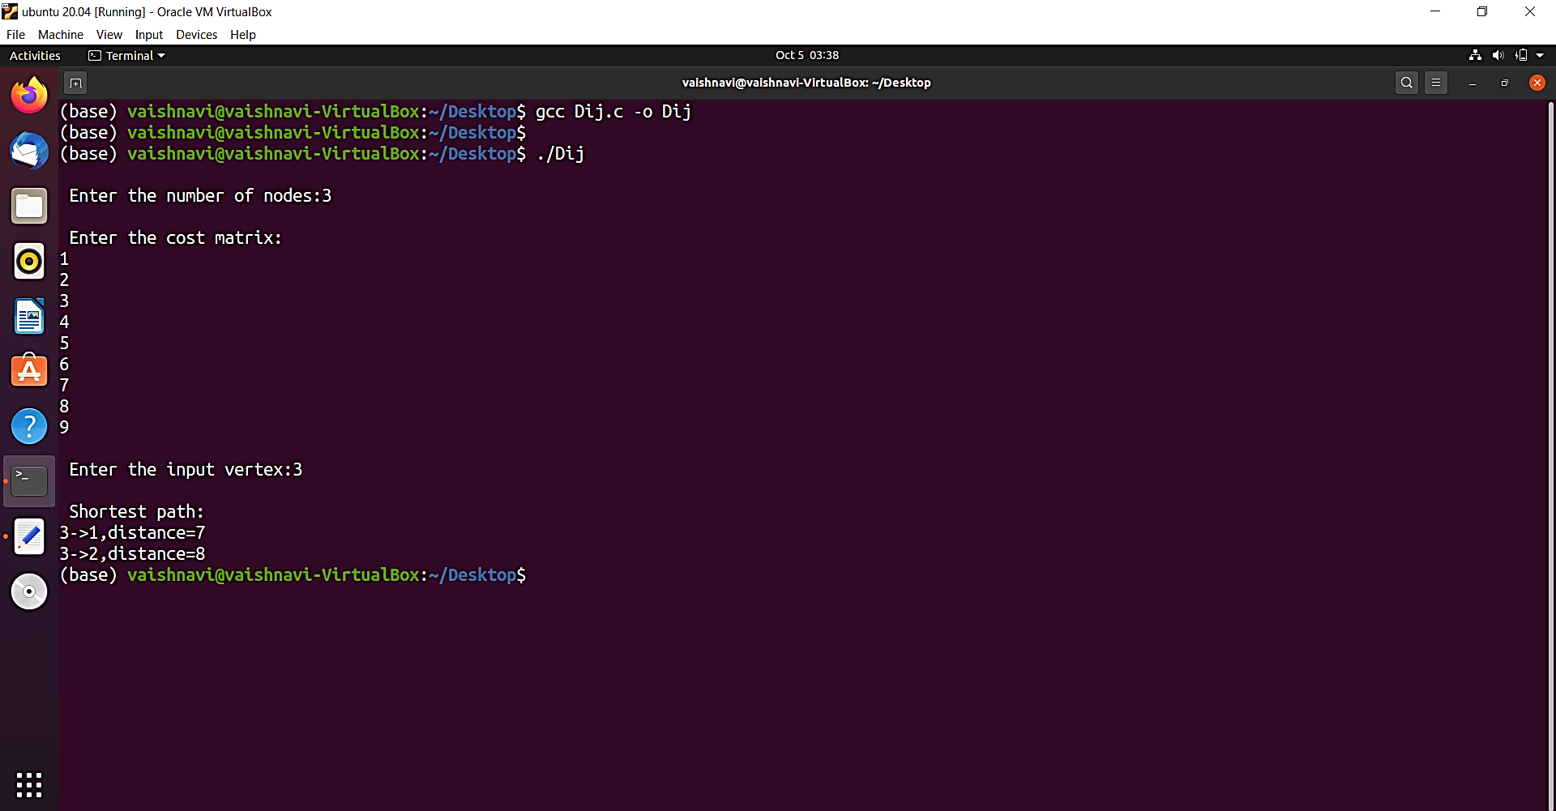

Slide 15
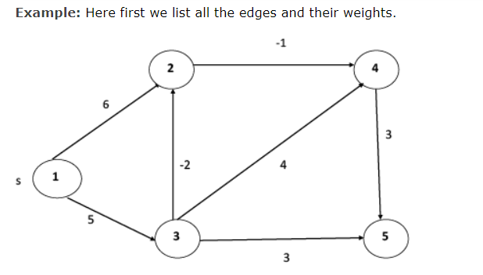
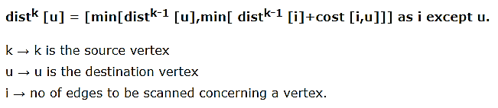
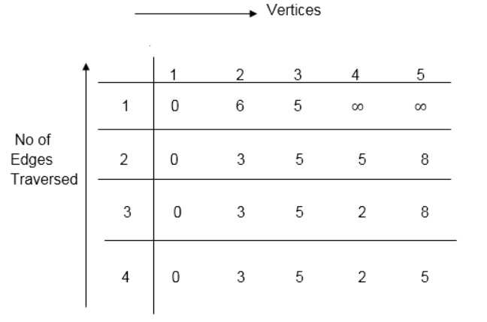
Bellman Ford Algorithm
This algorithm detects the negative cycle in a graph and reports their existence.
Based on the "Principle of Relaxation" in which more accurate values gradually recovered an approximation to the proper distance by until eventually reaching the optimum solution.

Slide 16
C Program of Distance Vector Routing, implemented using Bellman Ford Algorithm
C Program of Distance Vector Routing, implemented using Bellman Ford Algorithm
/*
Distance Vector Routing in this program is implemented using Bellman Ford Algorithm:-
*/
#include<stdio.h>
struct node
{
unsigned dist[20];
unsigned from[20];
}rt[10];
int main()
{
int costmat[20][20];
int nodes,i,j,k,count=0;
printf("\nEnter the number of nodes : ");
scanf("%d",&nodes);//Enter the nodes
printf("\nEnter the cost matrix :\n");
for(i=0;i<nodes;i++)
{
for(j=0;j<nodes;j++)
{
scanf("%d",&costmat[i][j]);
costmat[i][i]=0;
rt[i].dist[j]=costmat[i][j];//initialise the distance equal to cost matrix
rt[i].from[j]=j;
}
}
do
{
count=0;
for(i=0;i<nodes;i++)//We choose arbitary vertex k and we calculate the direct distance from the node i to k using the cost matrix
//and add the distance from k to node j
for(j=0;j<nodes;j++)
for(k=0;k<nodes;k++)
if(rt[i].dist[j]>costmat[i][k]+rt[k].dist[j])
{//We calculate the minimum distance
rt[i].dist[j]=rt[i].dist[k]+rt[k].dist[j];
rt[i].from[j]=k;
count++;
}
}while(count!=0);
for(i=0;i<nodes;i++)
{
printf("\n\n For router %d\n",i+1);
for(j=0;j<nodes;j++)
{
printf("\t\nnode %d via %d Distance %d ",j+1,rt[i].from[j]+1,rt[i].dist[j]);
}
}
printf("\n\n");
getchar();
}

Slide 17
